Slide 1


Gas leakage, Fire and Smoke Detection System with Alarm and SMS Alert MINI PROJECT (B-7)
Sreyas Institute of Engineering and Technology
An Autonomous Institution
Approved by AICTE, Affiliated to JNTUH
Accredited by NAAC-A Grade, NBA (CSE, ECE & ME) & ISO 9001:2015 Certified
DEPARTMENT OF ELECTRONICS & COMMUNICATION ENGINEERING
Presented by
T M CHANDANA (22VE1A04C1)
M NAREAN (22VE1A0493)
K SHYAM (22VE1A0488)

Slide 2
Abstract
This project introduces a smart safety system that utilizes integrated sensors to detect gas leakage, fire, and smoke in real time.
It employs MQ series gas sensors, flame sensors, and smoke detectors to monitor environmental conditions.
Upon detecting a hazard, the system activates a local alarm and sends SMS alerts to registered users via a GSM module, enabling immediate on-site and remote responses.
Designed for residential, commercial, and industrial use, the system offers reliability, affordability, and easy installation.
By combining sensor and communication technologies, it provides timely warnings to minimize risks, safeguard lives, and prevent potential damage or accidents.

Slide 3
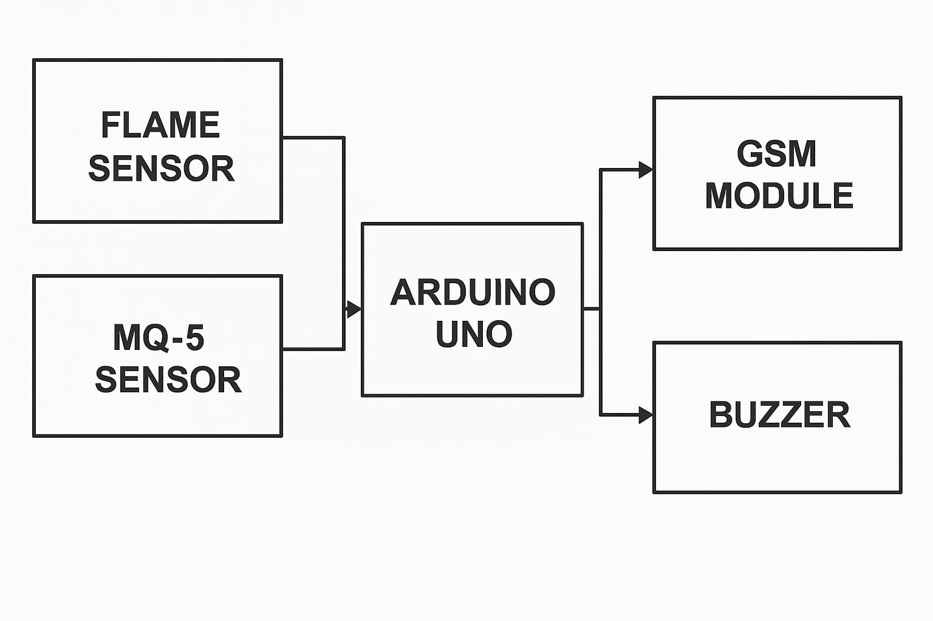
Block Diagram

Slide 4
Components Utilized
1.MQ2/MQ5 Sensor:
Detects gases like LPG, methane, and smoke in the environment.
2. Flame Sensor:
Detects the presence of fire or flame using infrared light.
3. GSM(SIM900A):
Sends SMS alerts to users over a mobile network.
4. Buzzer:
Emits a loud sound to alert users during an emergency.
5. ESP32/UNO:
Microcontrollers used to control and process data from all
connected sensors.

Slide 5
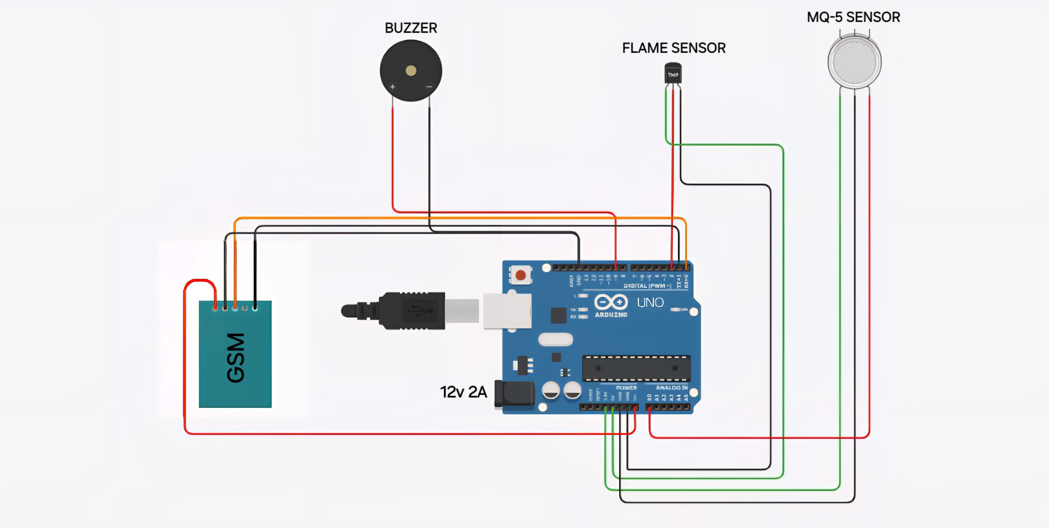
Circuit Diagram
Power supply: 12V,2A

Slide 6
PINS CONFIGURATION
Flame Sensor → D2
Gas Sensor (MQ-5) → A0
Buzzer → D9
GSM Module TX → D7
GSM Module RX → D8
All components → 5V and GND for power supply

Slide 7
How it works?
• The smart safety system is built using sensors connected to a
microcontroller like ESP32 or Arduino UNO.
• Gas (MQ2/MQ5), flame, and smoke sensors continuously monitor the environment.
• When any sensor detects a hazard, the microcontroller processes the data and activates a buzzer for a local alarm.
• At the same time, the GSM module (SIM800L) sends an SMS alert to registered users.
• The system provides real-time alerts for gas leaks, fire, or smoke, ensuring quick response and safety.
• It is affordable, easy to install, and suitable for use in homes, offices, and industries.

Slide 8
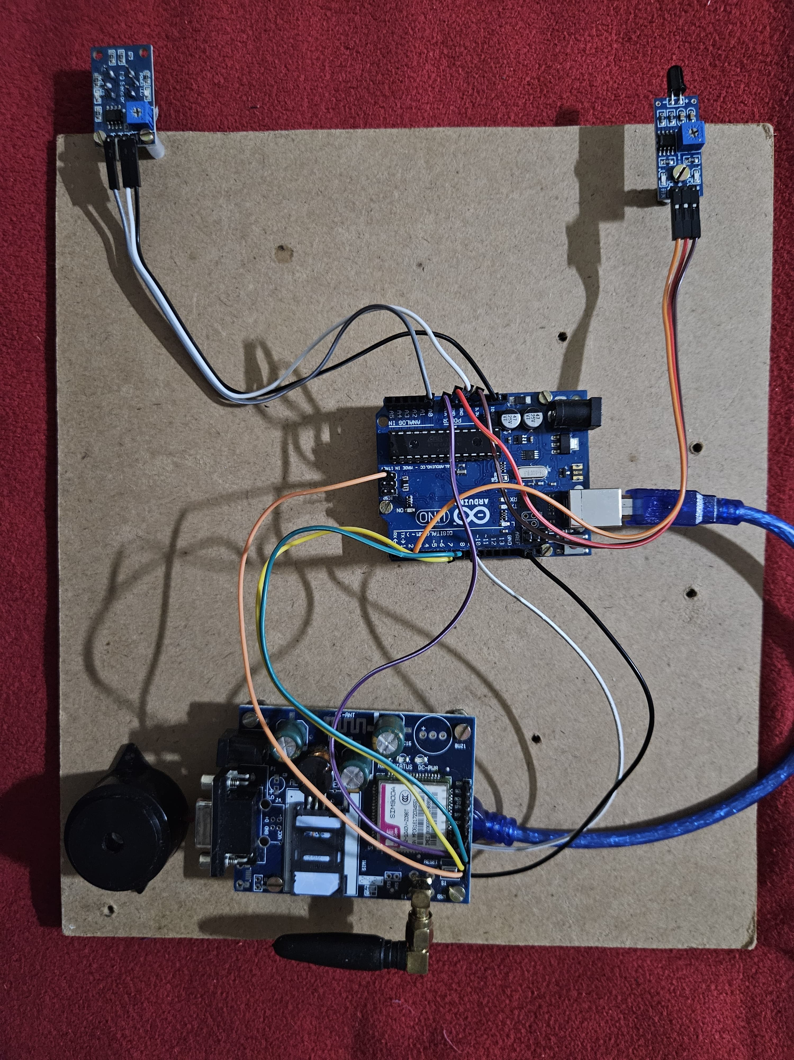
CIRCUIT PICTURE

Slide 9
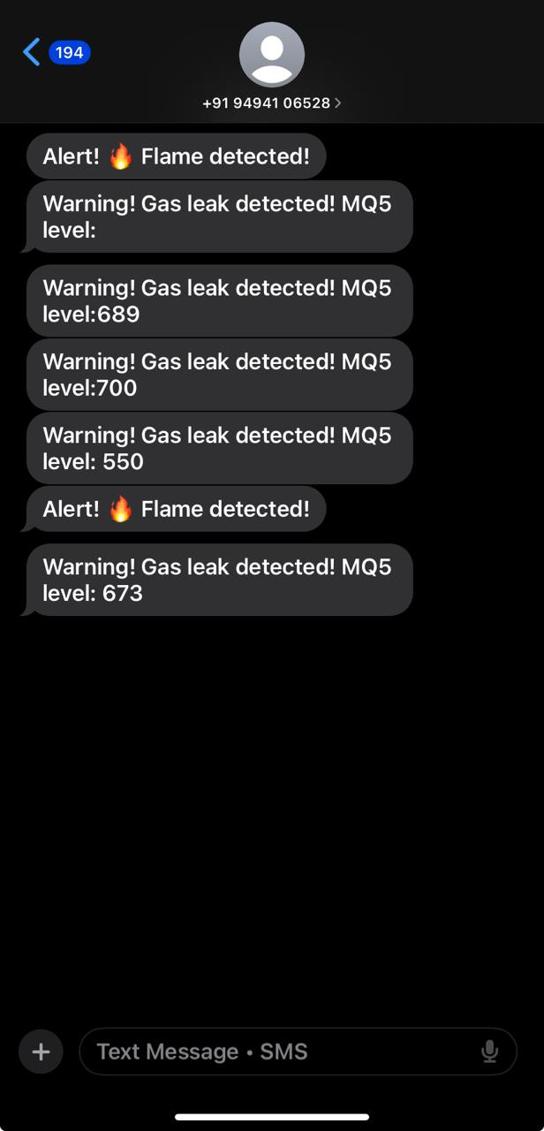
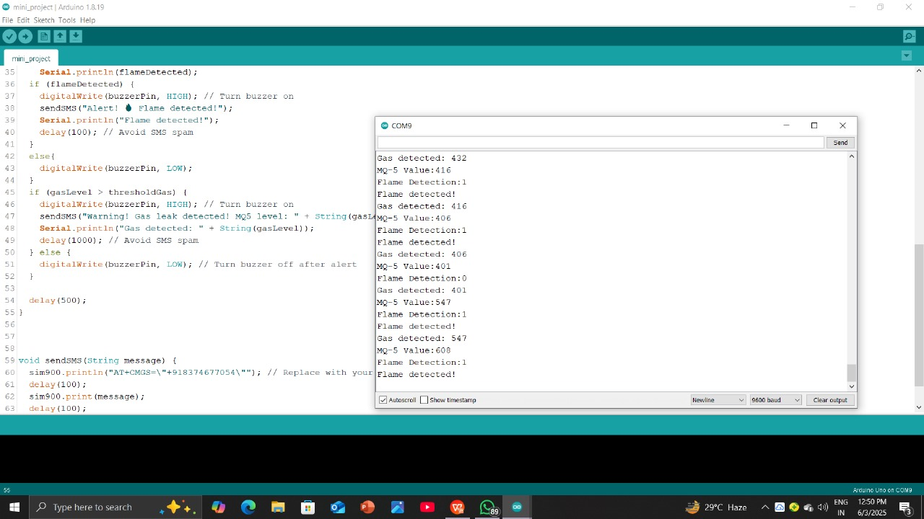
Simulation Results

Slide 10
Advantages
Detects gas, fire, and smoke early to prevent disasters.
Sends SMS alerts for remote notifications.
Activates buzzer alarm for immediate local warning.
Offers 24/7 real-time monitoring.
Reduces risk of injuries and fatalities.
Minimizes damage to property and equipment.
Cost-effective safety solution.
Easy to install and maintain.
Can be integrated with smart systems.
Scalable for home, office, or industry.

Slide 11
Applications
Homes – to detect kitchen fires or gas leaks.
Industries – for monitoring hazardous gas and fire.
Restaurants – to prevent kitchen-related incidents.
Hospitals – for enhanced patient and equipment safety.
Schools – for lab safety and fire prevention.
Offices – to protect staff and infrastructure.
Warehouses – to secure stored materials.
Public transport – for passenger safety.
Hotels – for guest and property protection.
Data centers – to safeguard electronic equipment.

Slide 12
Conclusion & Future Scope
This gas leakage, fire, and smoke detection system provides an effective safety solution by combining sensor-based alerts with buzzer and SMS notifications.
It ensures timely warnings, helping to prevent accidents, injuries, and property damage.
The system is reliable, easy to install, and suitable for homes, industries, and public places.
In the future, the system can be enhanced with IoT integration, mobile app control, automatic valve shut-off, and cloud-based data logging.
These upgrades will make it smarter, more responsive, and capable of real-time monitoring from anywhere in the world.

